Slide 1

Pyrolysis of Plastics
DE Project:
Visualisation of Process Engineering Application
Project Defense
Poorna Chandrasekar Pedhiredla Shubham Chandrakant Borkar Arjun Babu Chandra Mouleshwari Surendra Babu

Slide 2
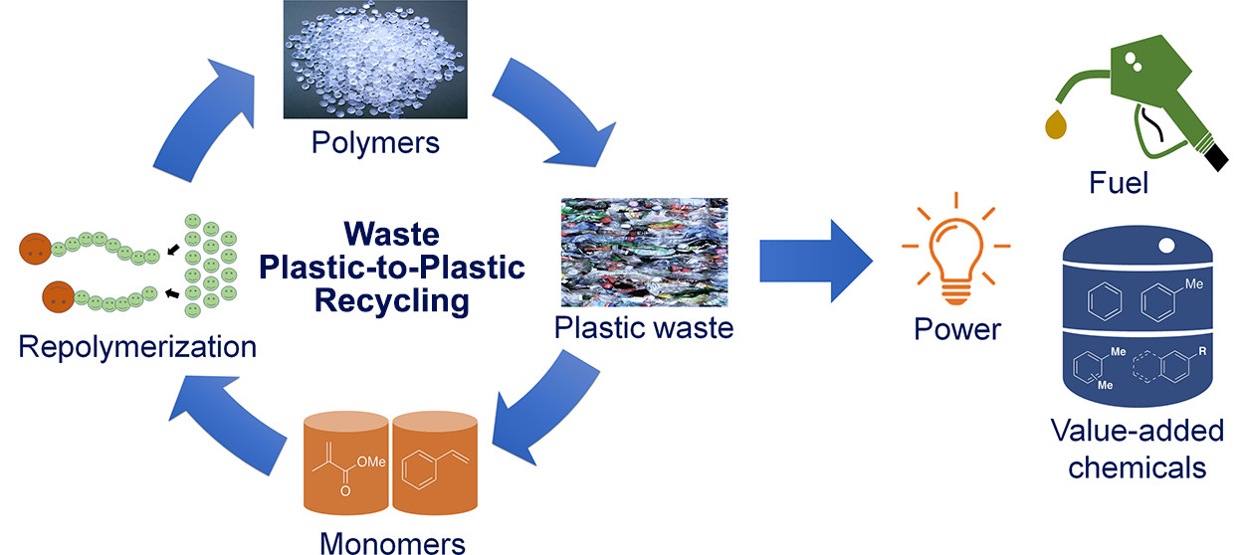
Introduction
Plastic waste pyrolysis is a thermochemical process that converts plastic polymers into valuable hydrocarbons in an oxygen-free environment.
This presentation highlights the key chemical engineering principles involved, including reactor design, reaction chemistry, mass and energy balances, and process control.
Mastery of these fundamentals is crucial for optimizing the conversion of plastic waste into fuels and chemical feedstocks, advancing sustainable waste management and energy recovery.
Source: https://www.elevate.in

Slide 3
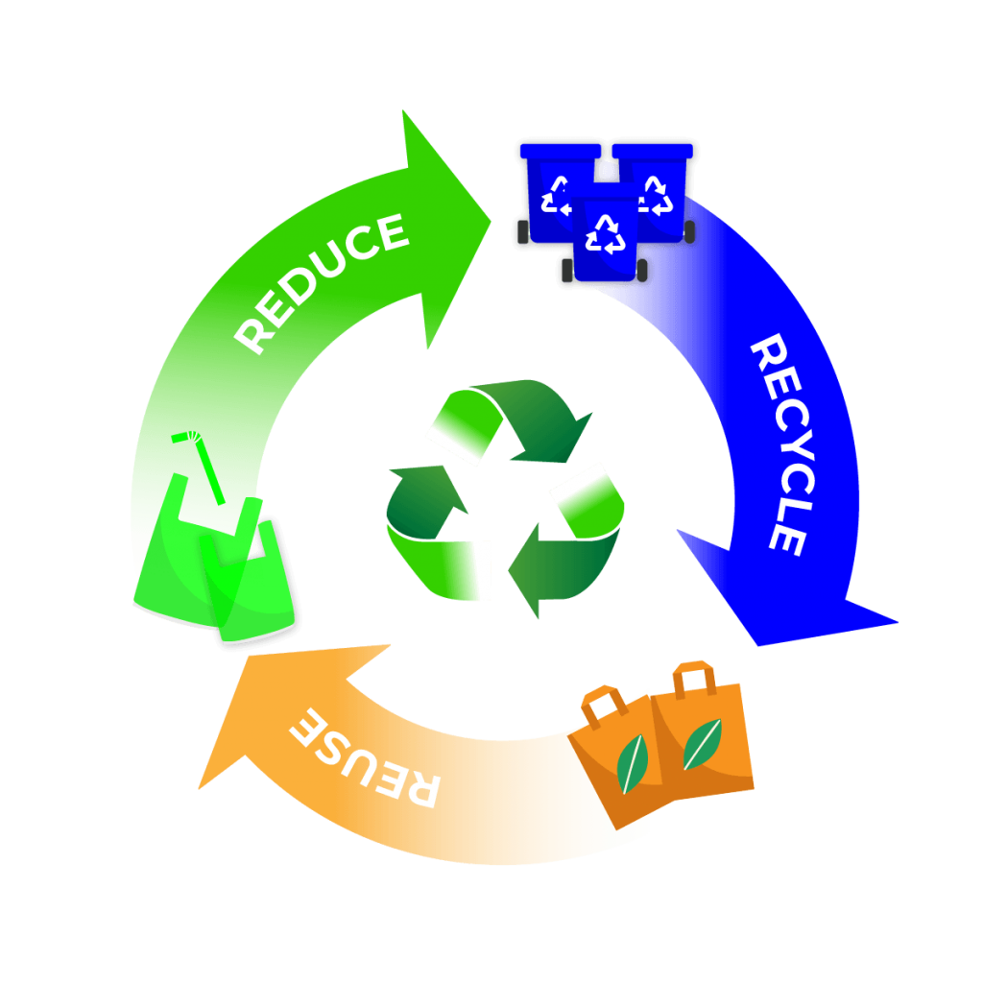
Why Choose Plastic Waste Pyrolysis?
Advantages Over Other Recycling Methods
Handles non-recyclable plastics effectively
Produces high-energy fuels and chemical feedstocks
Reduces landfill dependency and environmental harm
Lower energy demand compared to incineration
Usage
Converts plastic waste into fuels and chemicals, reducing landfill burden and promoting a circular economy.
1. Viable Solution
Addresses plastic pollution and resource depletion.
2. Environmental Benefits
Transforms waste into useful products.
3. Economic Advantages
Contributes to sustainability and economic value.
Source : https://cyplasticrecycling.com/

Slide 4



Pyrolysis Fundamentals and Feedstock Preparation
Pyrolysis Process
Feedstock Preparation
Key Parameters
Thermochemical breakdown of plastics at 300–900°C without oxygen, converting polymers into smaller hydrocarbons via cracking and other reactions.
Plastics are sorted, cleaned, and shredded to ≤20 mm for efficient heating. Typical materials: LDPE, HDPE, PP, PS.
Temperature, residence time, plastic type, catalysts, and reactor design affect product yields and reaction rates.

Slide 5
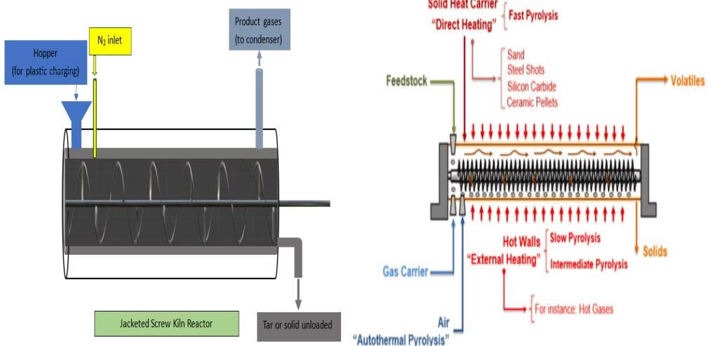
Reactor Design: Horizontal Screw Kiln Reactor
Reactor Specifications
Features
Materials: High-temp stainless-steel body, heat-resistant alloy screw
Horizontal orientation for efficient heat transfer and mixing
Length: 1.2 m; Diameter: 0.4 m; Volume: 0.151 m³
Sealed inert atmosphere with nitrogen purge
Screw diameter: 0.384 m; Rotation speed: 5-15 rpm
Anti-bridging feed system and pressure relief valve
Temperature monitoring at multiple points

Slide 6
Heating and Temperature Control Systems
Jacket Design
Heating Options
Reactor jacket with 0.1 m insulation thickness, baffles for uniform heating, made from high-temperature resistant steel with ceramic insulation.
Natural gas burner: 992 kW heat output, 80% efficiency
Electric coils: Nickel-chromium alloy, 1 kW power, uniform heat distribution
Temperature Control
Insulation
Multiple thermocouples with PID control maintain a 500°C target temperature, visualising temperature gradients along the reactor length.
Ceramic fibre or mineral wool insulation minimises heat loss, with stainless steel or aluminum cladding for protection.

Slide 7
Reaction Chemistry and Kinetics
Polymer Breakdown
Reaction Parameters
Polyethene: Random C-C bond scission producing propane, hexane
Activation energy: 200–300 kJ/mol
Heat of reaction: 420 kJ/kg
Polypropylene: Breaks at tertiary carbons, higher olefin content
Reaction rate constant: 0.005 s⁻¹
(Arrhenius behavior)
Polystyrene: Depolymerizes to styrene monomers and aromatics
Catalysts enhance cracking, isomerisation, and aromatics formation

Slide 8
Mass Balance Analysis
Inputs
2000 kg polyethene feed, nitrogen purge gas, 46 kg catalyst (2.3% mass fraction).
Conversion and Products
80% conversion at 500°C yields 1200 kg propane, 320 kg hexane, 80 kg tar, and 400 kg unconverted PE.
Mass and Carbon Balance
Total mass conserved at 2000 kg; carbon balance shows ~3% discrepancy within acceptable limits.

Slide 9


Energy Balance and Efficiency
Oxygen-Free Environment
Practical Input and Fuel Consumption
An oxygen-free environment is maintained by purging nitrogen into the reactor, preventing combustion and ensuring safe heating conditions.
Accounting for 80% heat transfer efficiency, the actual energy input is 3,571,250 kJ, consuming 71.43 kg natural gas per hour.

Slide 10

Motivation – Why This App Was Needed
Traditional texts fail to convey the dynamic nature of plastic-to-fuel conversion.
Students struggle to visualize the invisible chemical transformations.
Static images can't depict real-time process changes.
Enhances comprehension through visual learning.
Source: ChatGPT url: https://chat.openai.com.
Notes:
Let’s begin by looking at the motivation behind developing this application. Traditional teaching materials often fail to convey the dynamic and complex nature of converting plastic into fuel. Students face difficulty visualizing the invisible chemical reactions that occur during this process. Static diagrams and textbook illustrations simply can't represent real-time changes and motion. This is where visual learning becomes incredibly powerful—by turning abstract concepts into animated, engaging experiences.

Slide 11
Application Objective
Simulate plastic pyrolysis with educational accuracy
Enable intuitive understanding through 3D visuals
Translate invisible chemical steps into visible animations
Enhance process learning beyond static text or images
Notes:
Now that we understand the “why,” let’s move on to the “what” this app aims to achieve…
The core objective of this application is to simulate the plastic pyrolysis process with scientific and educational accuracy. We wanted to create an intuitive platform using 3D visuals that help students truly understand each phase. The app translates invisible chemical steps into visible animations that can be observed and followed. In short, we aim to move beyond static content and make complex chemical processes easier to learn.

Slide 12
Key Concepts Visualized
Plastic feed and thermal decomposition effects
Screw-based material movement
Gases generation and flow
Greenboard explanations
Notes:
With the objective in mind, let’s explore the core concepts this app visualizes…
The app begins by showing how plastic feed enters the reactor and how thermal decomposition takes place. It features screw-based material movement that transports the plastic through the system. Users can also observe how gases are generated and how they flow within the reactor. Throughout the process, a digital greenboard provides real-time textual explanations to reinforce understanding.

Slide 13
User Experience Goals
Clear 3D layout and visualisation
Step-by-step process animation
Real-time synced textual guidance
Interactive Buttons: Start, Back, Restart
Notes:
Next, let’s talk about how we designed the user experience to support effective learning…
We prioritized a clear and intuitive 3D layout that gives students a full view of the reactor and process flow. The animation walks through the process step by step, helping users follow the chemical reactions over time. Textual guidance appears in sync with the animation to explain each stage as it unfolds. To keep navigation simple and accessible, interactive buttons like Start, Back, and Restart are included.

Slide 14
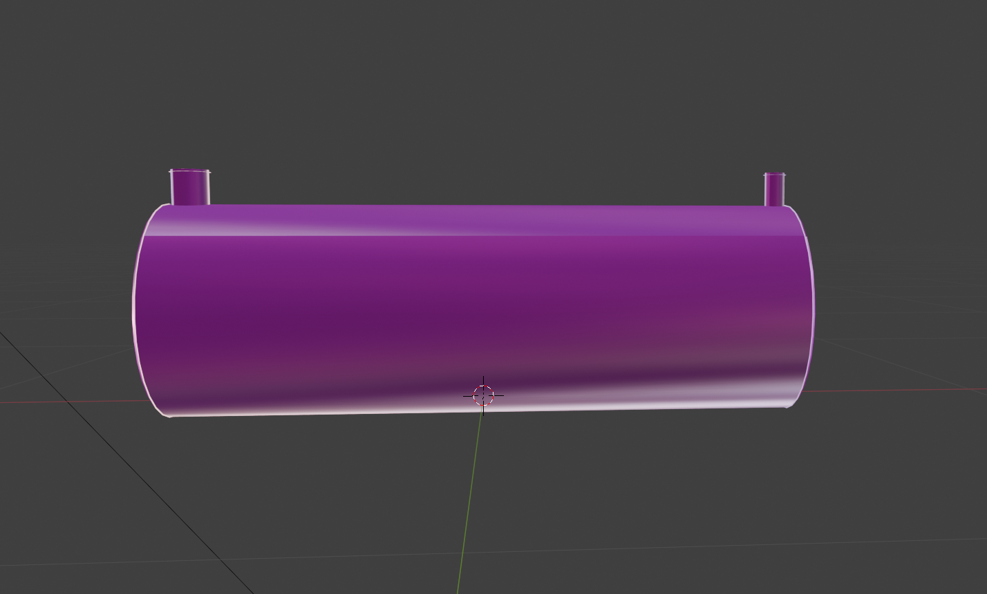
Implementation Tools
Blender for detailed 3D models
Developed in Unity, targeting Windows platforms
C# scripting for interactivity
Notes:
Now, let’s shift gears and take a look at the tools we used to bring this experience to life…
All 3D components were modeled using Blender, a powerful open-source tool known for its precision. The app itself was developed using Unity, which gave us flexibility and powerful rendering capabilities—especially for targeting Windows platforms. C# scripting was used extensively to control interactivity, animations, and user interface behavior throughout the app.

Slide 15
Game Engine and Core Features
Particle systems simulate gas flow and plastic decomposition
Physics system enables realistic movement
Box and mesh colliders control particle containment
Canvas system manages GUI: images, text, and buttons
Notes:
Building further on the implementation, here’s how Unity’s features were utilized to simulate the process realistically…
We used particle systems within Unity to simulate gas flow and plastic decomposition, adding dynamic realism. Physics systems were added to make the movement of particles and components behave naturally. To contain and manage the movement of particles, we used both box and mesh colliders. Lastly, Unity’s canvas system allowed us to build user interface elements such as images, buttons, and explanatory text seamlessly.

Slide 16
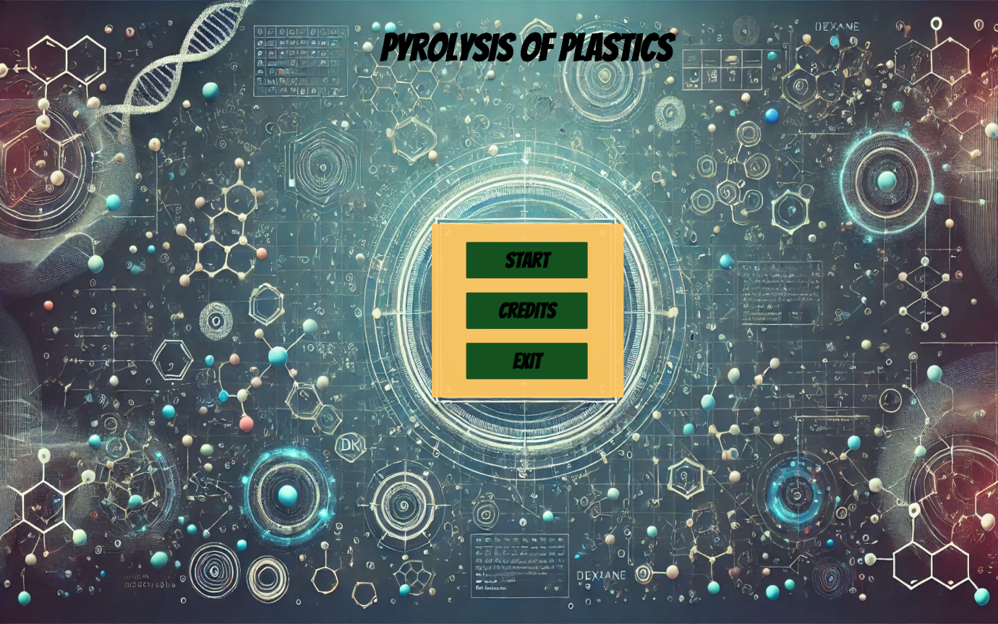
App Navigation and Layout
Home Scene with main menu
Credits Scene with team display
Process Animation Scene as core feature
○ Reactor placed centrally in layout
○ Greenboard for process updates
Notes:
Finally, let’s walk through the app’s structure and how users interact with it…
The app starts with a Home Scene that features the main menu, giving users access to different parts of the application. The Credits Scene showcases the development team and contributors with a visually engaging classroom-style design. The core of the application lies in the Process Animation Scene. Here, the reactor is placed at the center, and the greenboard at the top continuously updates with the latest process information. This layout keeps users focused and provides a smooth, cohesive learning journey.

Slide 17
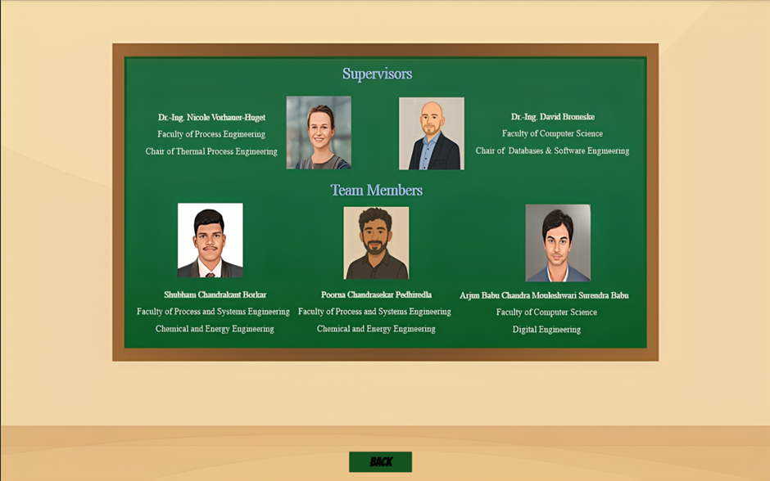
App Navigation and Layout
Home Scene with main menu
Credits Scene with team display
Process Animation Scene as core feature
○ Reactor placed centrally in layout
○ Greenboard for process updates
Notes:
Finally, let’s walk through the app’s structure and how users interact with it…
The app starts with a Home Scene that features the main menu, giving users access to different parts of the application. The Credits Scene showcases the development team and contributors with a visually engaging classroom-style design. The core of the application lies in the Process Animation Scene. Here, the reactor is placed at the center, and the greenboard at the top continuously updates with the latest process information. This layout keeps users focused and provides a smooth, cohesive learning journey.

Slide 18
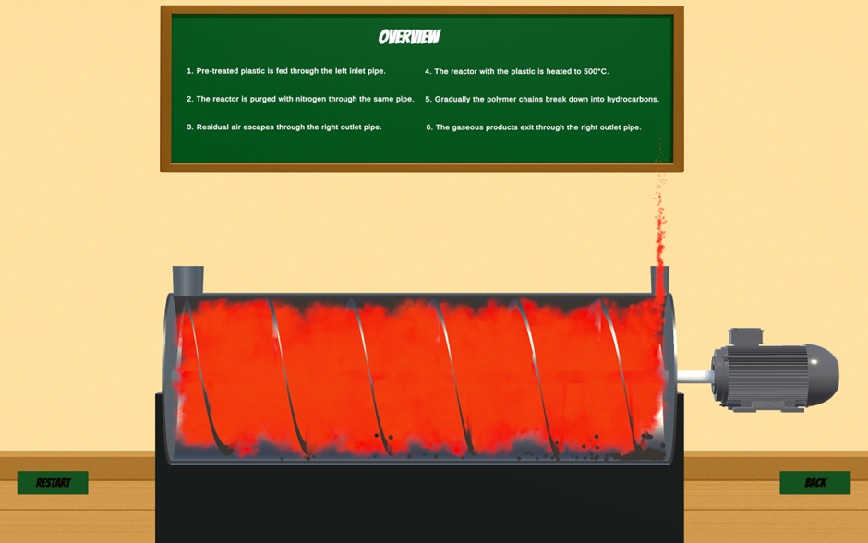
App Navigation and Layout
Home Scene with main menu
Credits Scene with team display
Process Animation Scene as core feature
○ Reactor placed centrally in layout
○ Greenboard for process updates
Notes:
Finally, let’s walk through the app’s structure and how users interact with it…
The app starts with a Home Scene that features the main menu, giving users access to different parts of the application. The Credits Scene showcases the development team and contributors with a visually engaging classroom-style design. The core of the application lies in the Process Animation Scene. Here, the reactor is placed at the center, and the greenboard at the top continuously updates with the latest process information. This layout keeps users focused and provides a smooth, cohesive learning journey.

Slide 19
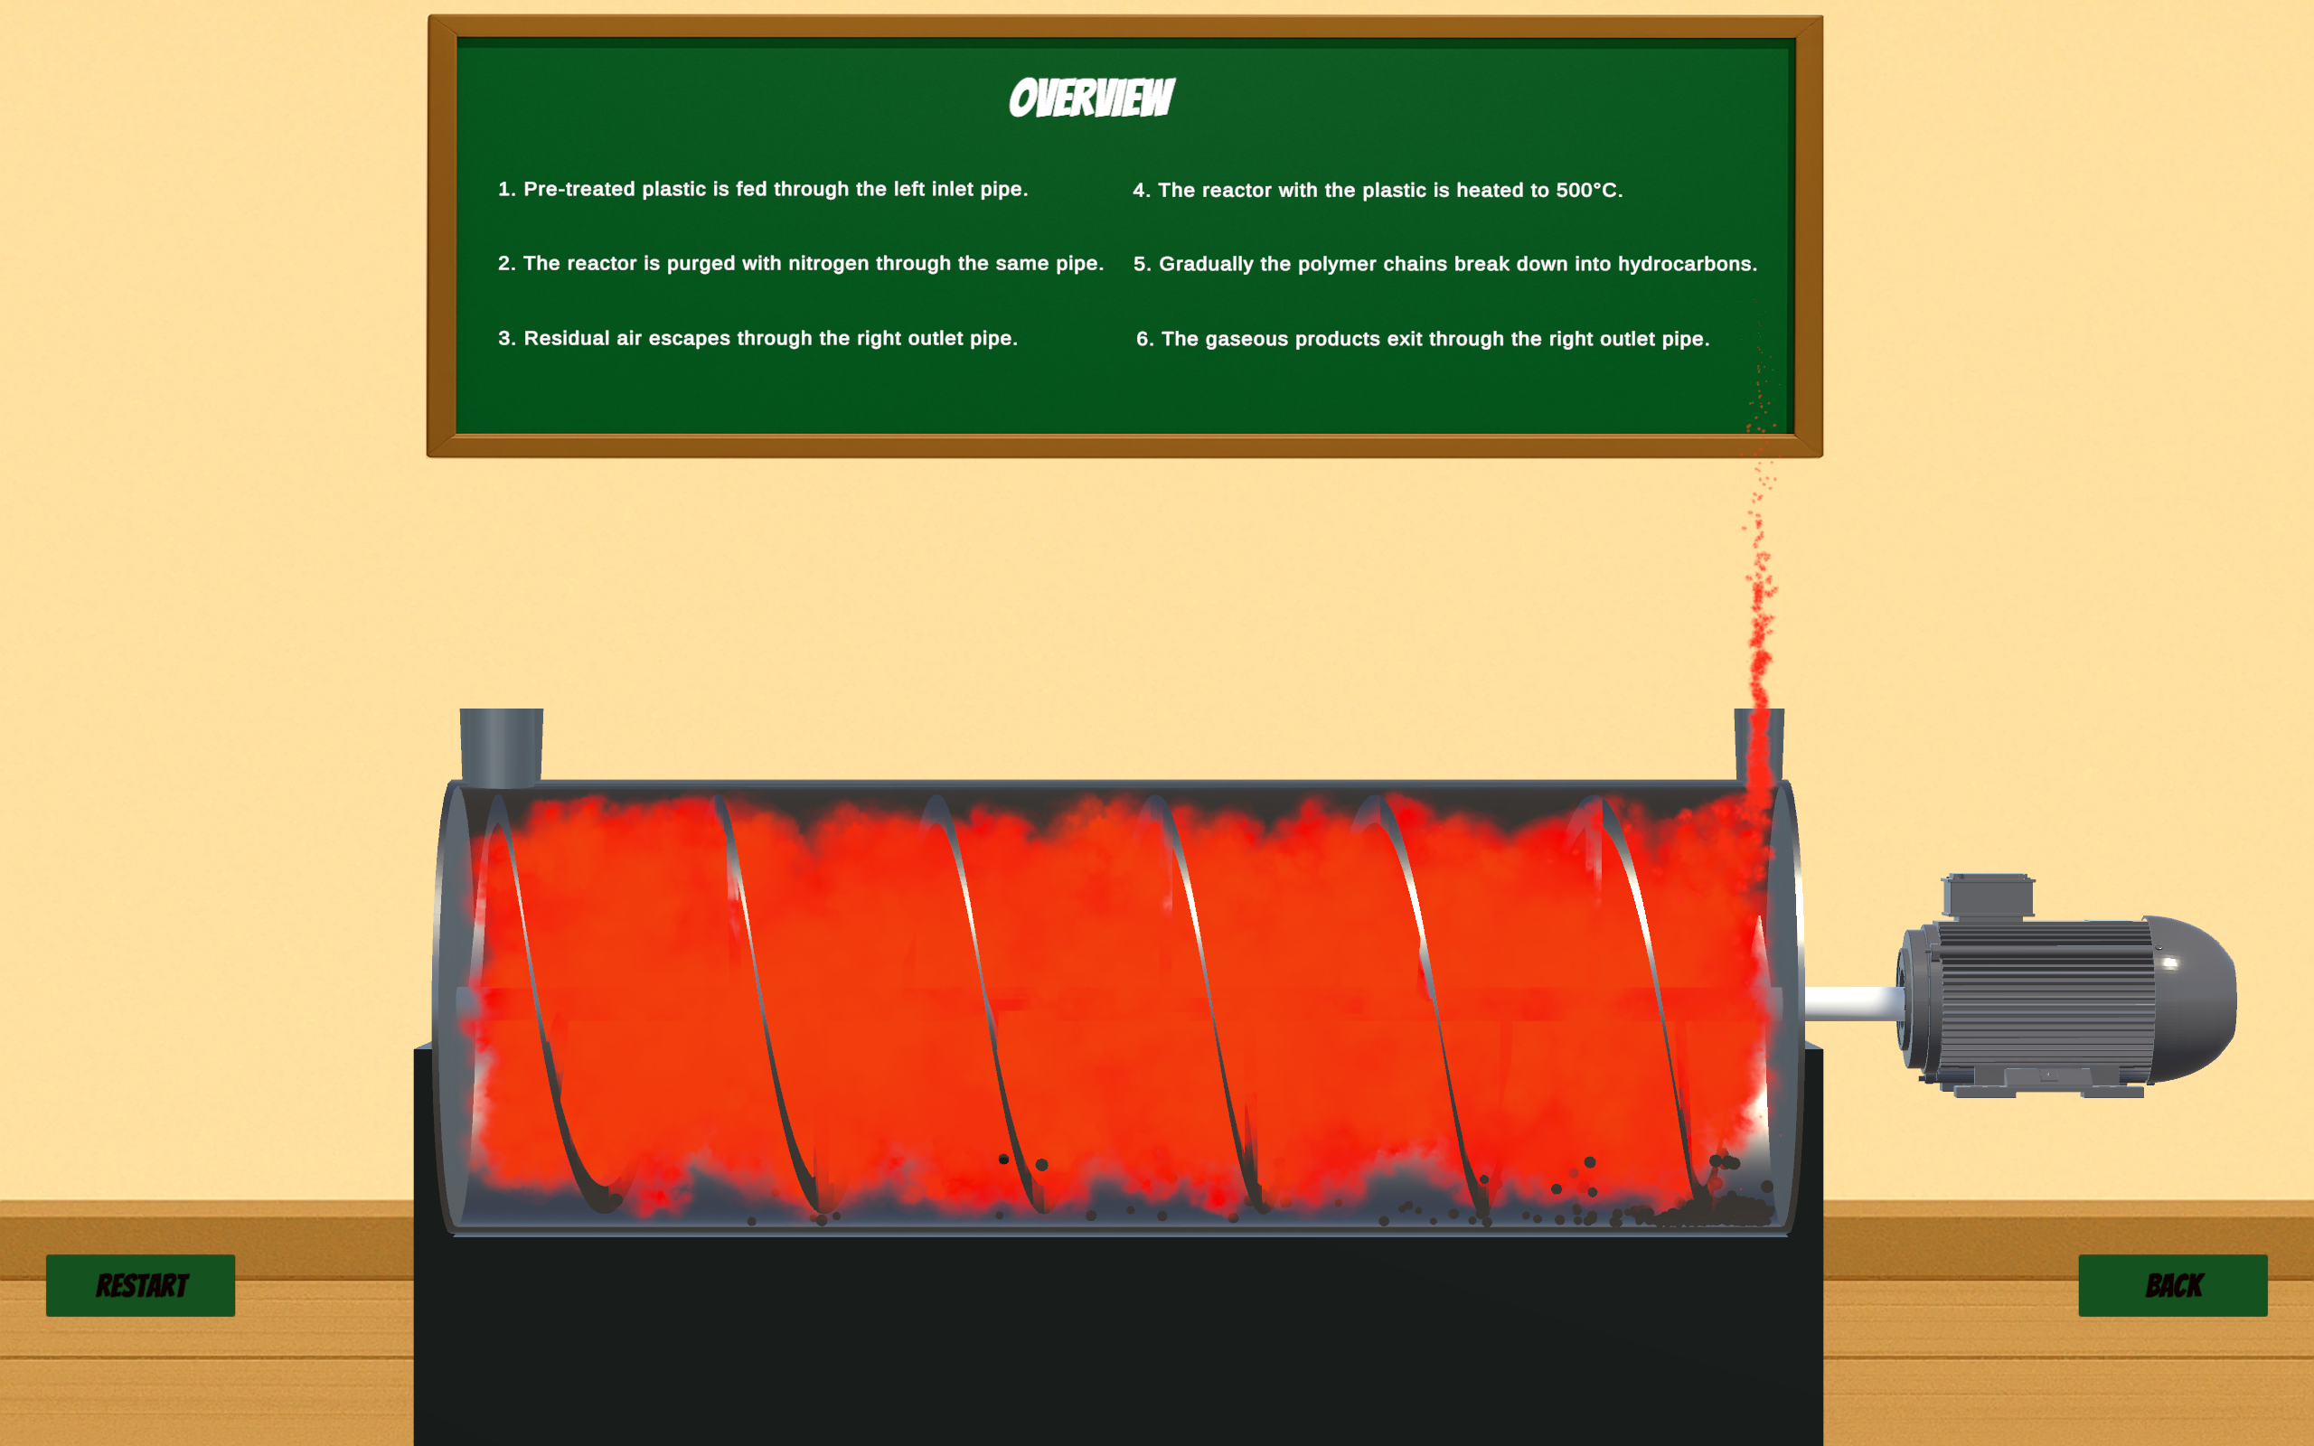
Process Animation Scene
Plastics and Nitrogen gas are fed through the inlet pipe
Yellow-to-red gas colour change for heat
Plastic particles shrink and vanish
Open outlet simulates real gas flow
Text appears in sync with each step
Notes:
Now that we’ve looked at how the app is built, let’s dive into its most dynamic component—the Process Animation Scene…
In this scene, plastics and nitrogen gas are introduced together through the inlet pipe, initiating the simulation. As the reactor heats up, the gas visually changes color—from yellow to red—indicating rising temperature. Inside the reactor, plastic particles begin to shrink and eventually vanish, visually representing their thermal decomposition. The outlet remains open throughout the simulation to allow continuous flow of gas, mimicking real-world pressure management. To guide users, explanatory text appears on the greenboard in perfect sync with each animation step, enhancing understanding at every stage.

Slide 20
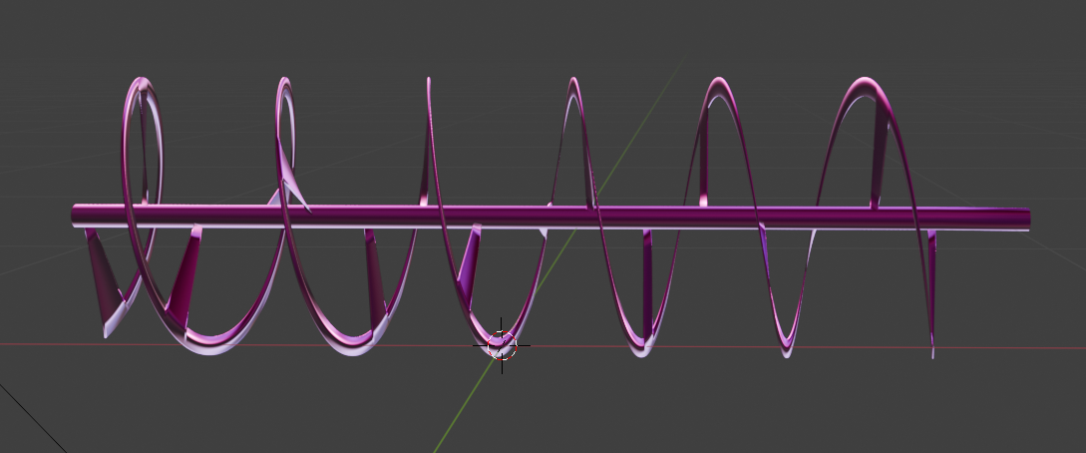
Project Challenges
Difficult Screw Conveyor modelling in Blender
Semi-transparent reactor material setup
Precise camera placement for correct 3D projection
Gas particles flickering under default pipeline
Particle containment required complex hidden colliders
Notes:
Creating a realistic and functional simulation came with several technical challenges…
One of the most complex tasks was modeling the screw conveyor in Blender, which involved precise geometry and movement. Designing the semi-transparent material for the reactor was another hurdle, especially while maintaining visual clarity. We also had to carefully place the camera to ensure the 3D layout projected correctly and looked natural to the user. Initially, gas particles flickered or disappeared due to rendering issues in Unity’s default pipeline. We addressed this by integrating the Universal Render Pipeline, which provided much-needed visual stability and improved performance. Additionally, to prevent particles from escaping the reactor, we had to design and place multiple hidden colliders, making the containment look seamless.

Slide 21
Highlights & Achievements
Scientific accuracy from real reactor specs
High gas emission rate at inlet enhances simulation realism
Simulating realistic gas turbulence
Gradual gas colour change with temperature
Continuous expulsion of outlet gases
Notes:
Despite the challenges, several achievements stand out from the project…
The simulation is grounded in scientific accuracy, using real reactor specifications and operational parameters. A high emission rate at the inlet pipe adds a sense of realism, visually emphasizing the active gas flow. We also successfully simulated realistic gas turbulence to mirror actual process behavior. The gas gradually changes color with increasing temperature, reinforcing the concept of thermal progression. Lastly, continuous gas expulsion at the outlet maintains consistency with industrial design and helps users visualize dynamic pressure flow.

Slide 22
Highlights & Achievements
Plastic particles shrink and disappear to represent chemical conversion
Gas dilution is shown by visibly decreasing density near reactor outlet
Synchronized greenboard text and animation
Auto screw control based on animation progress
Fully responsive across screen sizes
Notes:
Continuing with key highlights…
The shrinking and disappearance of plastic particles were scripted to represent their conversion into gaseous products in real-time. Toward the end of the reactor, gas dilution is clearly visualized by a decrease in particle density—helping users recognize that fewer products remain. The greenboard text is perfectly synchronized with the animation, offering explanations precisely when each process stage begins. The screw rotates automatically and stops at the correct time, thanks to custom scripting based on animation progress. And to ensure accessibility, the app was tested across various screen sizes and resolutions and performs responsively in all cases.

Slide 23
Future Work
Add 3D models for catalyst & fuel systems
Display live graphs (temp vs. product yield)
Simulate heat transfer dynamically
Notes:
Looking ahead, here’s what could be added in future iterations…
We plan to incorporate 3D models for catalyst beds and the fuel purification system to expand the learning scope. Live graphs showing temperature versus product yield could provide a more analytical and data-driven learning layer. Lastly, adding a dynamic heat transfer simulation would help visualize energy distribution and reactor heating more comprehensively.

Slide 24
Conclusion
App successfully simulates plastic pyrolysis
Combines modelling, animation and scripting
Provides real-world accurate, intuitive visual learning
This help users understand the process comprehensively
Notes:
To wrap up…
The application successfully simulates the pyrolysis process of plastic waste, capturing its essential physics and chemistry. It integrates 3D modeling, custom animation, and interactive scripting into a single seamless educational experience. By replicating a real-world process visually and accurately, the app offers an intuitive and engaging way for students to grasp complex concepts. Ultimately, it serves as a powerful tool for enhancing chemical engineering education through visual and experiential learning.

